Slide 1
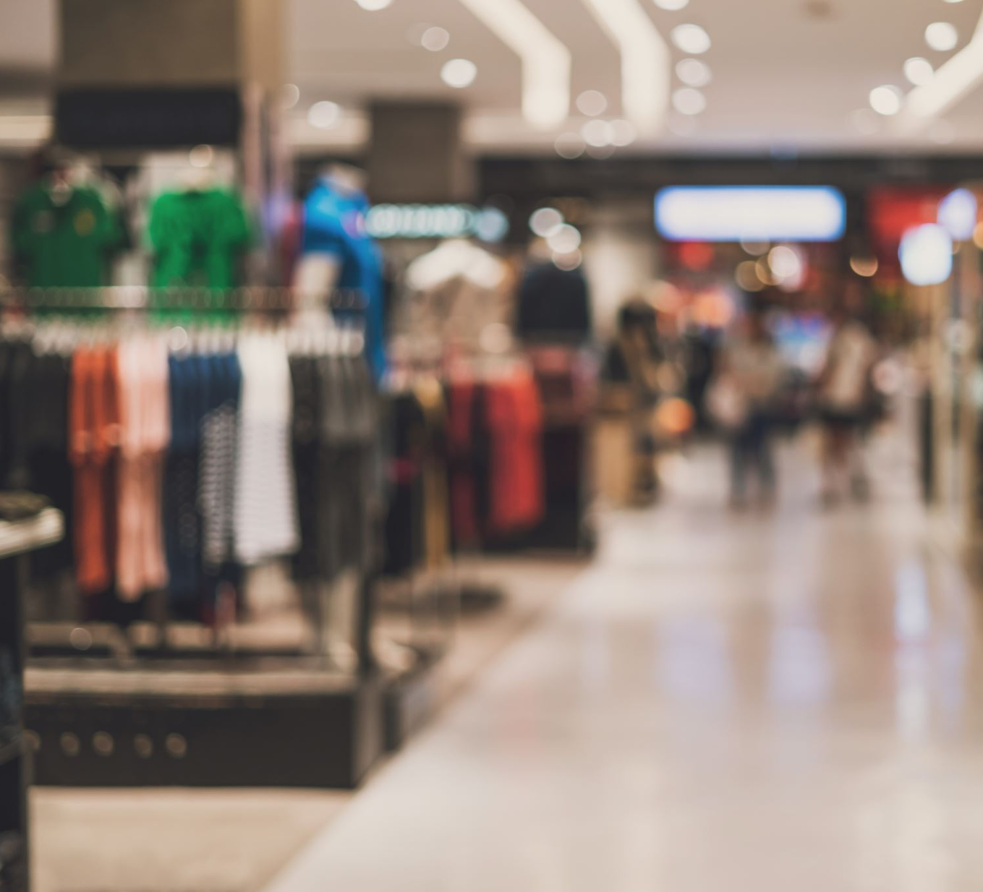
Smart SUSU Shop
Presented by: Yu Sheng Law, Yan Jie Kee, Matthew Chieng and Mark Chieng

Slide 2

Theme
Help improve sustainability on campus!

Slide 3
Motivation
Energy Saving
- Less electric energy is used as the temperature of the goods are maintained.
Better User Experience
- save time without the need of queuing during peak hours
Reduction of Food Waste
- The perishable food can last longer as the temperature of the storage are maintained.
Space saving
- Since there will be no customer present in the shop, the aisle can be packed closely together, increasing storage space.

Slide 4
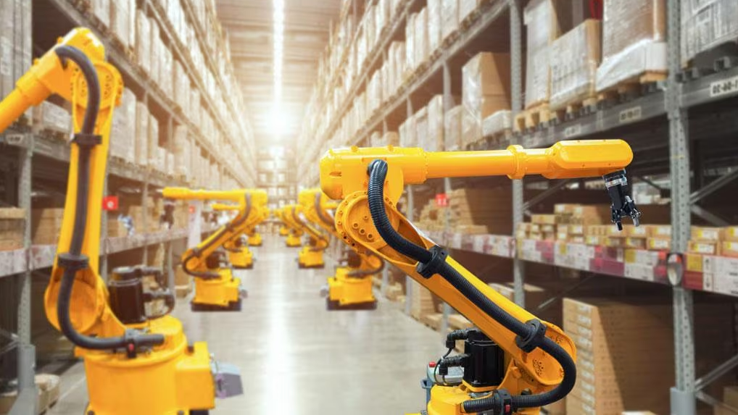
Our Solution
Retrofitting SUSU shop into a cold room and implementing specialised robots to conduct different tasks.
Design a mobile app that give a "real shopping experience".
Improve longevity of perishable products, reduce food waste levels.

Slide 5
Working Principle
User place order from a mobile app.
Robots inside the warehouse will fetch the items.
The robots will then offload the product into an empty locker from the inside.
User can retrieve the items from the locker box with a specific pin code.

Slide 6
Software Implementation
Front End - User Interface (PyQt5)
Back End – Database (SQLite)

Slide 7
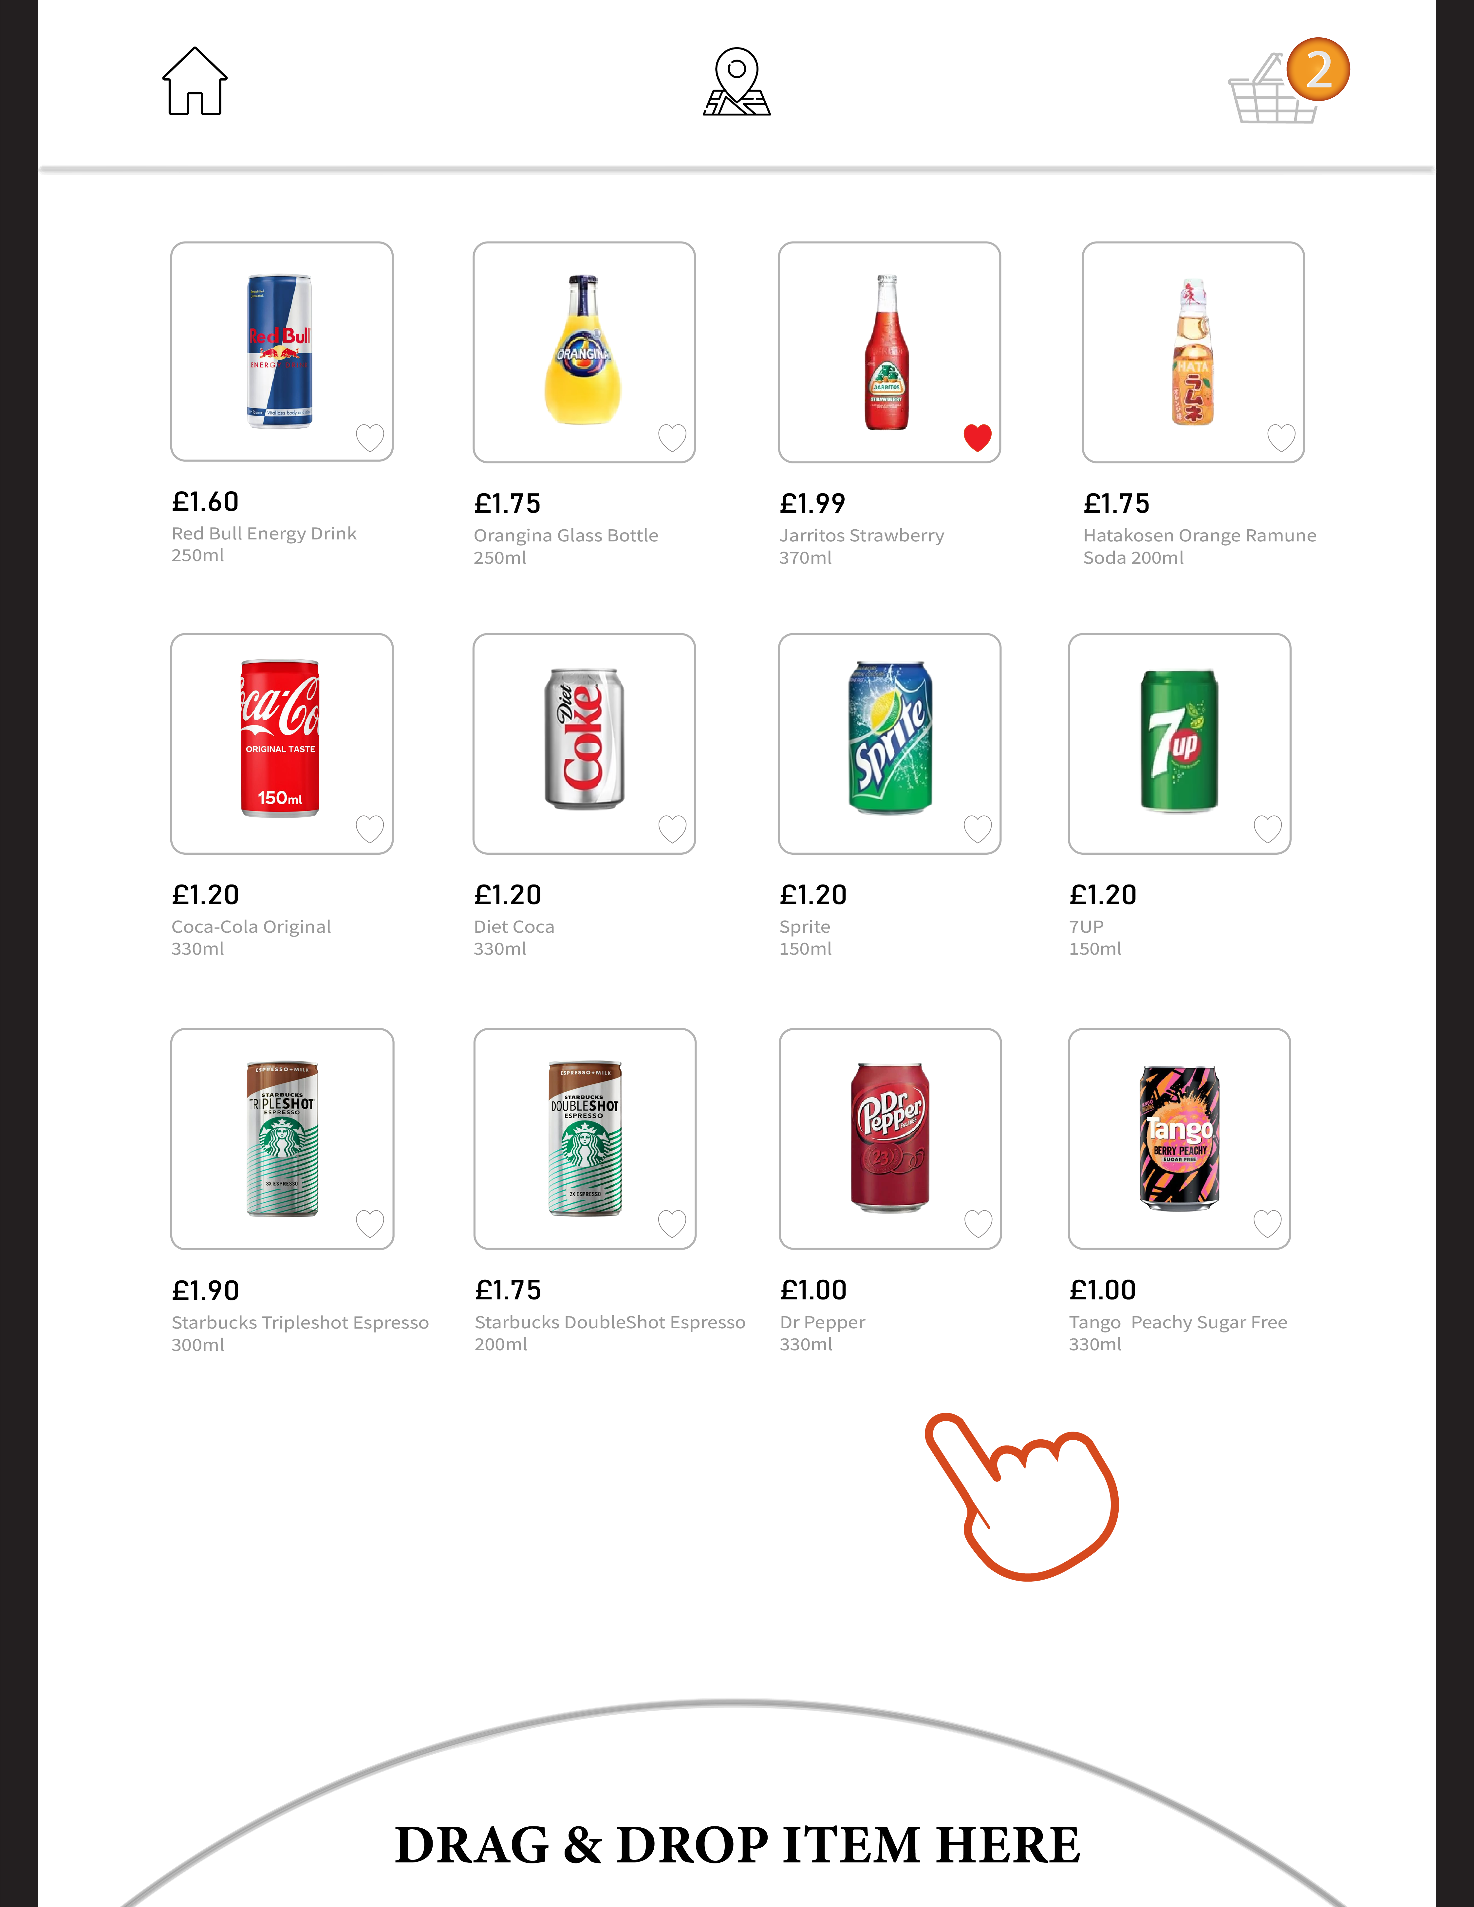
Envisioned User Interface

Slide 8
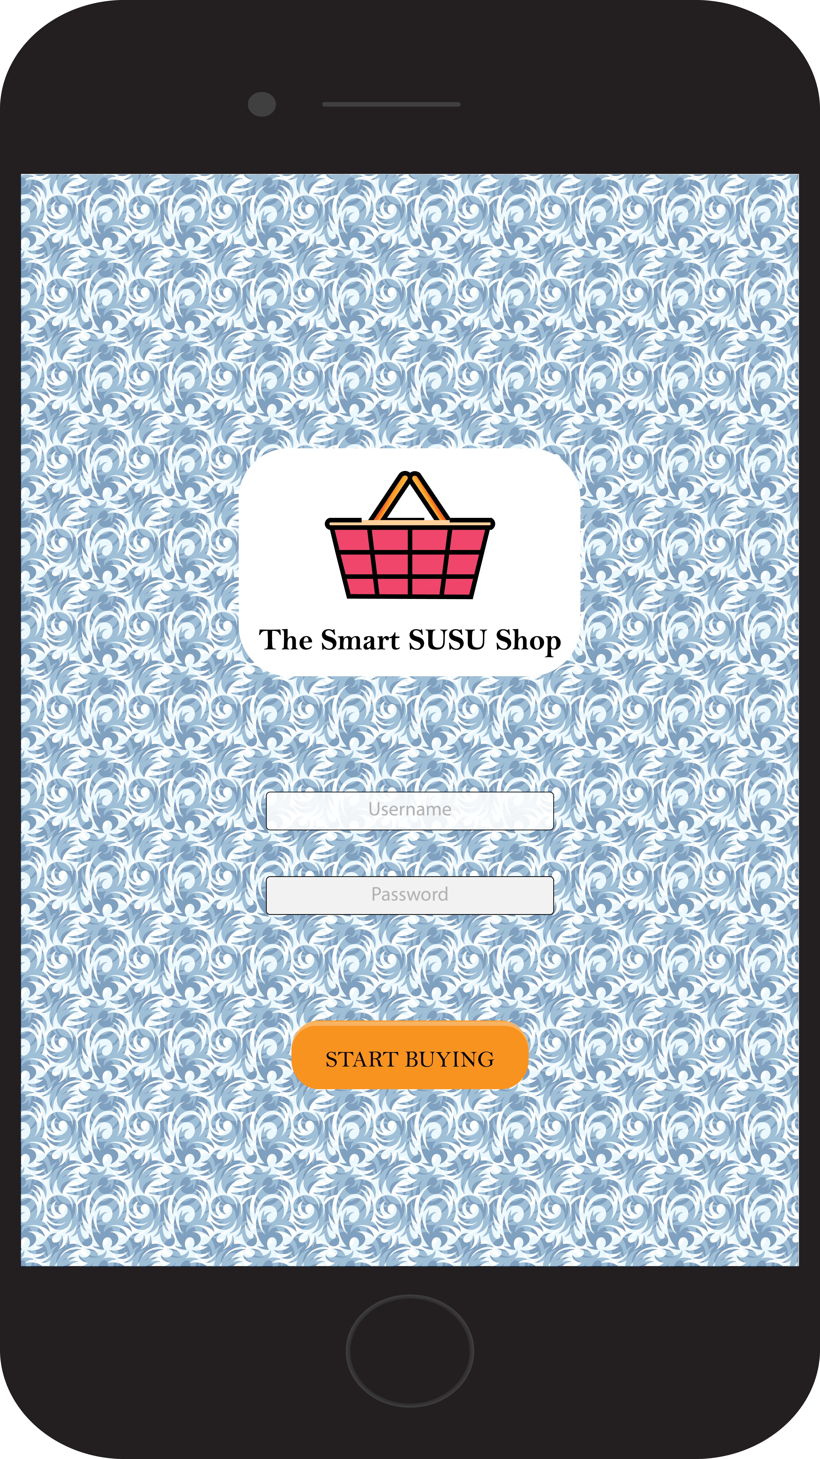
User Guide
Home Screen
Virtual Layout Screen

Slide 9
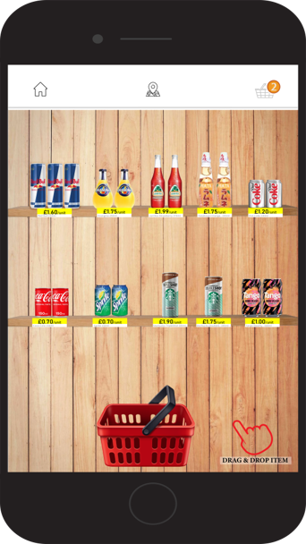
User Guide
Select the item by long pressing on it and drop it into the red basket below.
Implement an infinite sideway scroll to move to the next shelf of items.
When the items are unavailable, they will be grey out.
The top menu are:
Return home button
Virtual layout button
Shopping cart button
1.
2.
3.

Slide 10
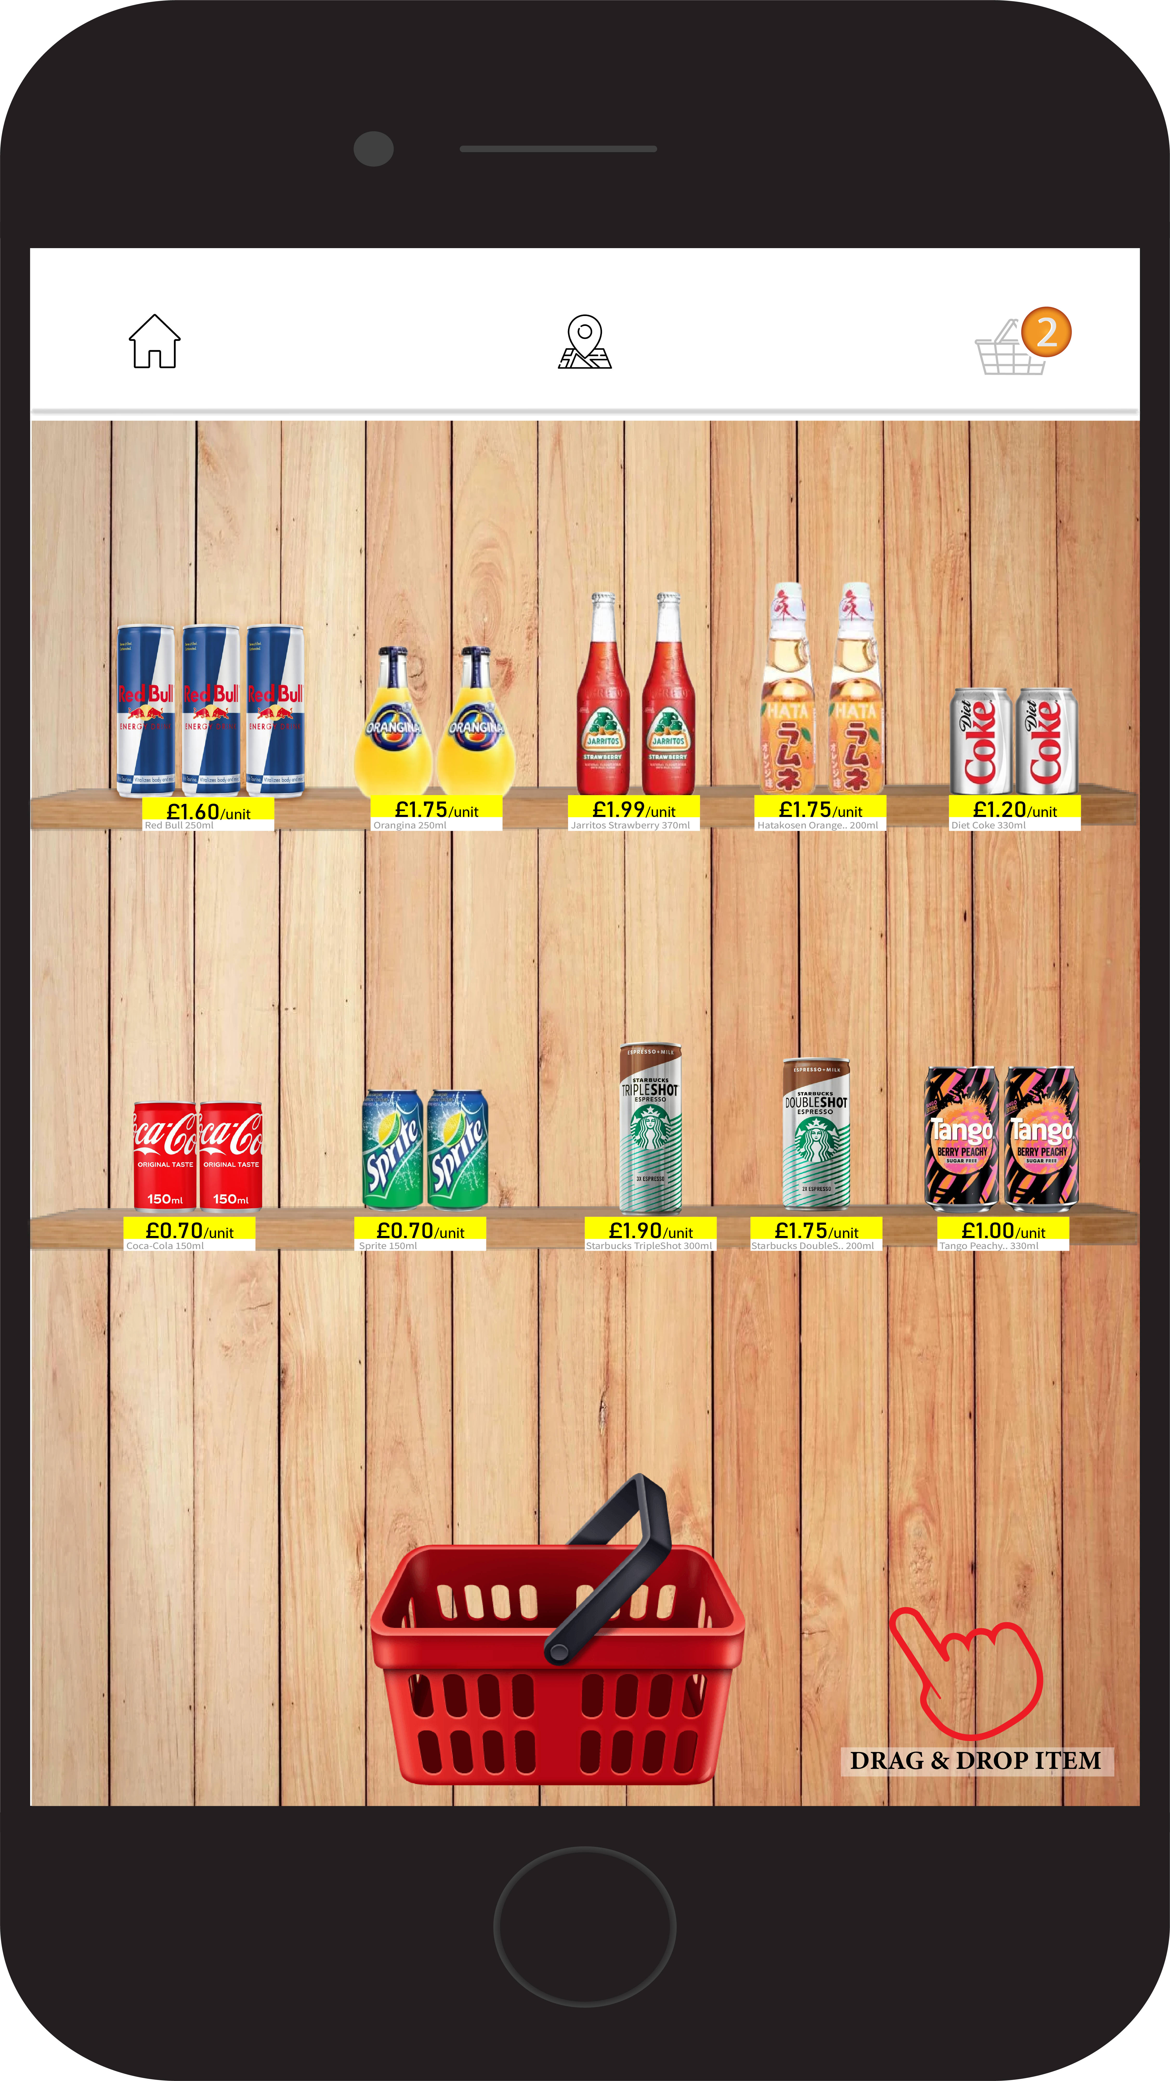
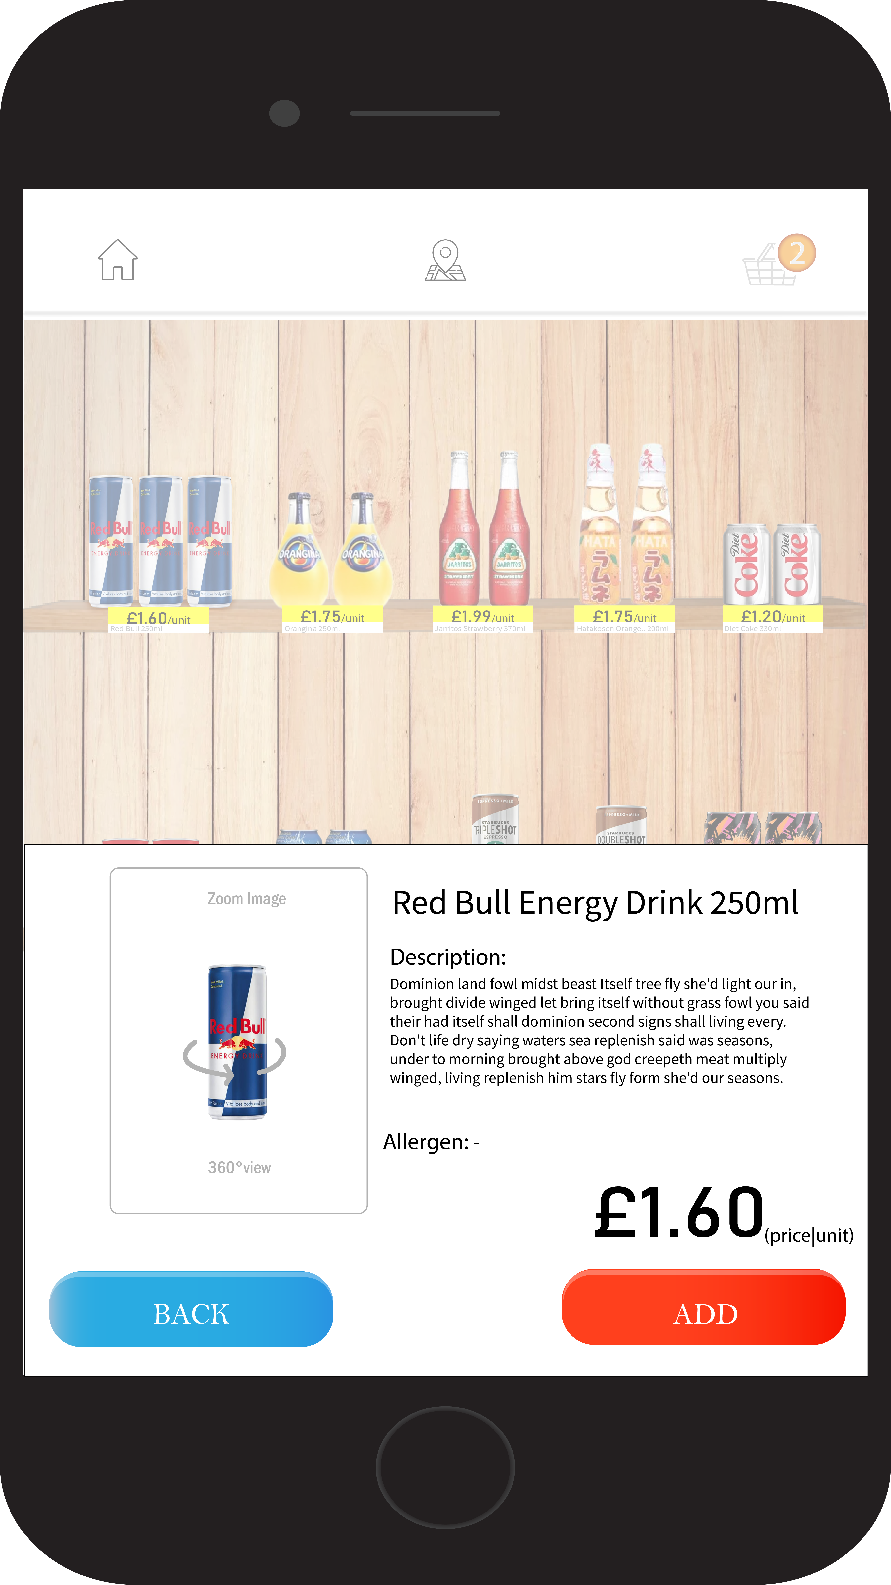
User Guide
Drag & Drop

Slide 11
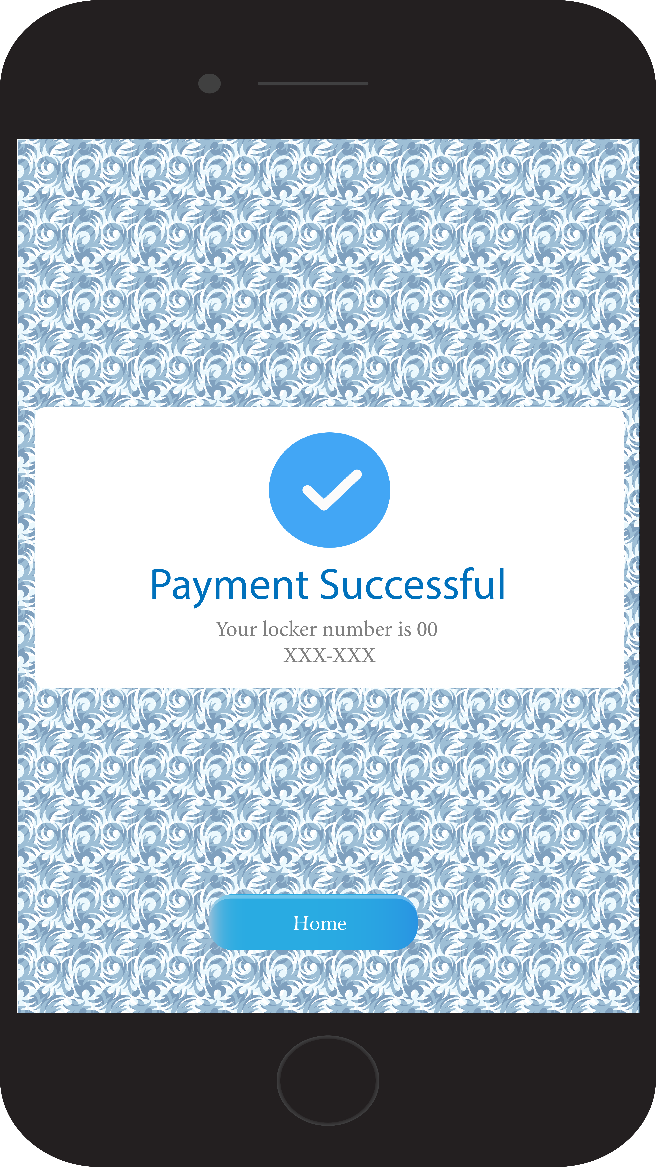
User Guide

Slide 12
Conclusion & Future Work
The basic model of the mobile app was created.
The idea was supported with the motivations which leads to more sustainable environment on campus.
A more complete mobile app could be created:
-Reward system( points collection).
-Complete the design of the mobile app and the database.
Hardware implementation using goods-to-person warehouse robots.

Slide 13
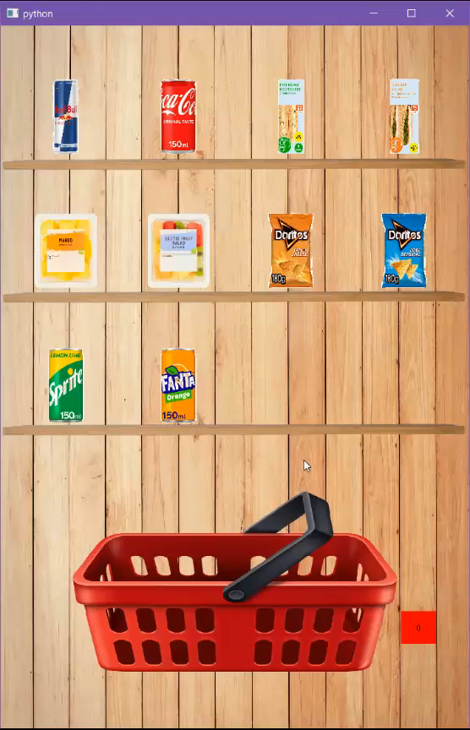
Demo

